Slide 1
INTELLIGENT STORAGE SYSTEMS AND RAID
UNIT II

Slide 2
SYLLABUS
Components of an intelligent storage system - Components - addressing - and performance of hard disk drives and solid-state drives - RAID - Types of intelligent storage systems - Scale-up and scale out storage Architecture.

Slide 3
Introduction to Intelligent Storage System (ISS)
An Intelligent Storage System (ISS) is an advanced storage solution designed to store, protect, manage, and optimize data efficiently. Unlike traditional storage devices, it contains built-in hardware and software that automatically perform tasks such as caching, RAID management, error detection, monitoring, and data recovery.
In modern data centers, Intelligent Storage Systems ensure that data is:
  Always available
  Secure
  Highly reliable
  Easily accessible
  Protected against hardware failures

Slide 4
Why Do We Need Intelligent Storage Systems?
Organizations today generate huge volumes of data every second.
Examples include:
Banks storing customer transactions
Hospitals maintaining patient records
Universities managing student databases
E-commerce websites storing product and customer information
Cloud service providers hosting millions of users

Slide 5
Why Do We Need Intelligent Storage Systems?
A simple hard disk is not sufficient because organizations require:
High speed
Large storage capacity
Fault tolerance
Continuous availability
Backup and recovery
Easy management
An Intelligent Storage System fulfills all these requirements.

Slide 6
Example
Imagine a college library.
Instead of books being placed randomly, the library has:
  Shelves (Storage)
  Librarian (Controller)
  Index Cards (Addressing)
  Backup Register (RAID)
  Reading Desk (Cache)
  Security Guard (Protection)
Similarly, an Intelligent Storage System organizes, protects, and retrieves digital data efficiently.

Slide 7
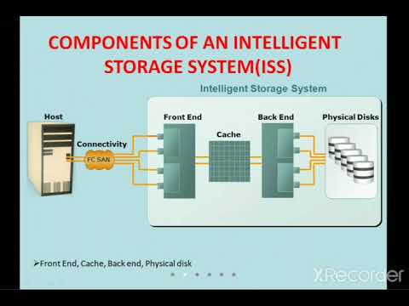
Architecture of an Intelligent Storage System

Slide 8
2.2 Components of an Intelligent Storage System
The major components are:
  Host Interface (Front-End Interface)
  Storage Controller
  Cache Memory
  RAID Controller
  Physical Storage Devices
  Back-End Interface
  Power Supply
  Cooling System
  Management Software

Slide 9
1. Host Interface (Front-End Interface)
Definition
The front-end interface connects the server to the storage system.
It receives read and write requests from applications.
Examples include:
Fibre Channel (FC)
iSCSI
NVMe over Fabrics
SAS

Slide 10
1. Host Interface (Front-End Interface)
Functions
Accepts I/O requests from the server
Transfers commands to the storage controller
Returns requested data to the server
Supports high-speed communication
Example
When a student logs into the college ERP portal, the login request travels through the front-end interface to access the student database.

Slide 11
2. Storage Controller
Definition
The storage controller is the brain of the Intelligent Storage System.
It manages all storage operations.
Functions
Controls data movement
Manages read and write operations
Performs RAID calculations
Maintains storage mapping
Detects hardware failures
Performs load balancing
Manages cache memory

Slide 12
2. Storage Controller
Importance
Without the storage controller, the storage system cannot organize or retrieve data efficiently.
Example
Just as the CPU controls all operations in a computer, the storage controller controls all operations inside the storage system.

Slide 13
3. Cache Memory
Definition
Cache memory is a high-speed temporary memory that stores frequently accessed data.
It acts as a buffer between the server and the storage disks.
Why Cache is Needed
Hard disks are relatively slow.
Instead of reading data from the disk every time, frequently used information is stored in cache.
This reduces access time significantly.

Slide 14
Types of Cache
Read Cache
Write Cache
Stores frequently read data.
When users request the same data again, the controller supplies it directly from cache without accessing the disk.
Advantages:
Faster response
Reduced disk operations
Lower latency
Stores data temporarily before writing it to disks.
Advantages:
Faster write operations
Better throughput
Reduced waiting time for applications
To prevent data loss during power failure, enterprise storage uses battery-backed cache or flash-backed cache.

Slide 15
4. RAID Controller
Definition
The RAID controller manages multiple storage disks as one logical storage unit.
Functions
Performs data striping
Creates mirrored copies
Calculates parity
Detects disk failures
Rebuilds failed disks

Slide 16
4. RAID Controller
Example
Suppose four hard disks are installed.
The RAID controller decides:
Which disk stores the data
Which disk stores parity
How failed data can be recovered

Slide 17
5. Physical Storage Devices
These are the actual devices where data is permanently stored.
Types include:
Hard Disk Drives (HDD)
  Store data magnetically.
Advantages
Low cost
High capacity
Disadvantages
Slower
Mechanical failures possible

Slide 18
5. Physical Storage Devices
Solid State Drives (SSD)
Store data electronically using flash memory.
Advantages
Very fast
Low power consumption
No moving parts
Disadvantages
Higher cost

Slide 19
6. Back-End Interface
The back-end interface connects the storage controller with the physical disks.
Common technologies:
  SAS
  SATA
  NVMe
Functions:
Transfers data between controller and disks
Supports multiple disks simultaneously

Slide 20
7. Power Supply
Storage systems usually contain redundant power supplies.
If one power supply fails, another continues supplying power.
Benefits:
Continuous operation
Increased availability

Slide 21
8. Cooling System
Storage systems generate heat due to continuous operation.
Cooling fans maintain proper temperature.
Benefits:
Prevent overheating
Increase hardware lifespan
Maintain stable performance

Slide 22
9. Storage Management Software
Management software helps administrators monitor and manage the storage system.
Functions include:
  Capacity monitoring
  Health monitoring
  RAID configuration
  Performance analysis
  Alert generation
  User management
Examples:
Dell EMC Unisphere
NetApp ONTAP
HPE Storage Management

Slide 23
Data Flow in an Intelligent Storage System
Step 1
User requests a file.
Step 2
The request reaches the front-end interface.
Step 3
The storage controller checks the cache.
Step 4
If data exists in cache, it is returned immediately.
Otherwise,
Step 5
The controller retrieves data from HDD or SSD
Step 6
The data is sent back to the user.

Slide 24
2.3 Components, Addressing and Performance of Hard Disk Drives (HDDs) and Solid-State Drives (SSDs)

Slide 25
1. Introduction
Storage devices are the backbone of every computer system. They permanently store operating systems, applications, databases, multimedia files, and user data.
There are two major storage technologies:
Hard Disk Drive (HDD) – Magnetic Storage
Solid State Drive (SSD) – Flash Memory Storage
Both devices perform the same function but use different technologies.

Slide 26
What is a Hard Disk Drive?
A Hard Disk Drive (HDD) is a non-volatile storage device that stores digital information using magnetic recording on rotating platters.
Since the data remains even after power is turned off, it is called non-volatile memory.
Components of a Hard Disk Drive
  1. Platters
  2. Spindle
  3. Read/Write Head
  4. Actuator Arm
  5. Actuator
  6. Controller Board (PCB)
  7. Cache Memory (Buffer)
  8. SATA/SAS Interface

Slide 27
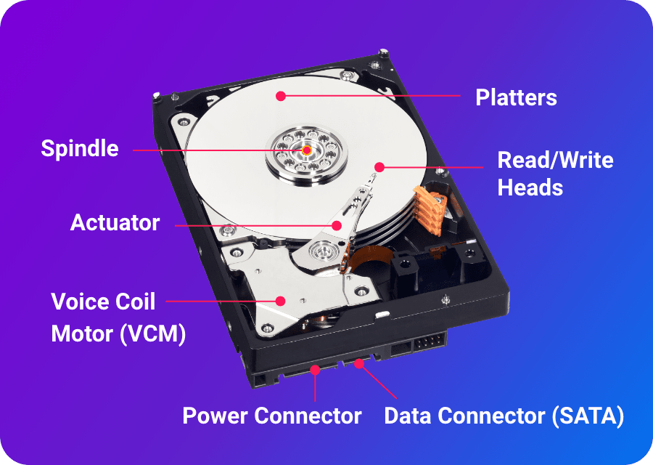
Components of a Hard Disk Drive

Slide 28
1. Platters
The platter is the most important component of an HDD.
Circular aluminium or glass disks
Coated with magnetic material
Rotates continuously
Data is stored magnetically
A hard disk may contain multiple platters.
Example
A 2 TB HDD may have four platters, each storing approximately 500 GB.

Slide 29
2. Spindle
The spindle holds all platters together.
Functions:
Rotates platters
Maintains constant rotational speed
Common spindle speeds:
5400 RPM
7200 RPM
10000 RPM
15000 RPM (Enterprise Drives)
Higher RPM means faster data access.

Slide 30
3. Read/Write Head
Each platter surface has one read/write head.
Functions:
  Reads magnetic data
  Writes magnetic data
  The head never touches the platter.
  It floats approximately 5–10 nanometres above the platter using an air cushion.

Slide 31
4. Actuator Arm
The actuator arm moves the read/write heads.
Purpose:
Positions the head over the correct track
Uses electromagnetic force
Movement is extremely precise.

Slide 32
5. Actuator
Controls movement of the actuator arm.
Usually consists of:
  Voice Coil Motor (VCM)
  It moves the head from one track to another within milliseconds.

Slide 33
6. Controller Board (PCB)
Located underneath the drive.
Functions:
  Controls motor
  Manages read/write operations
  Error correction
  Communication with CPU
  Acts as the brain of the HDD.

Slide 34
7. Cache Memory (Buffer)
Small RAM inside HDD.
Typical sizes:
  32 MB
  64 MB
  128 MB
  256 MB
Purpose:
Stores frequently accessed data
Reduces waiting time

Slide 35
8. SATA/SAS Interface
Used for communication with the computer.
Common interfaces:
SATA
  Personal computers
  6 Gbps
SAS
  Enterprise storage
  12 Gbps
  Higher reliability

Slide 36
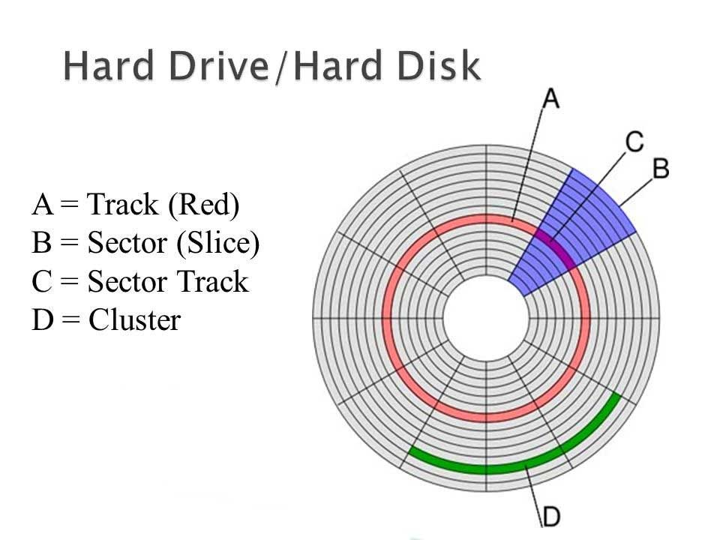
HDD Internal Organization

Slide 37
HDD Internal Organization
Data is stored in a structured manner.
Track
  A track is a circular path on the platter.
  Each platter contains thousands of tracks.
Sector
  Tracks are divided into sectors.
  Smallest storage unit.
  Traditional sector size: 512 Bytes
  Modern Advanced Format: 4096 Bytes (4 KB)

Slide 38
HDD Internal Organization
Cylinder
  A cylinder consists of tracks at the same position on all platters.
  Example
  If a hard disk has four platters,
  Track 100 on every platter together forms Cylinder 100.
Cluster (File System Level)
  Operating systems store files in clusters.
  Example
  NTFS cluster size:
  4 KB

Slide 39
Addressing in HDD
Why Addressing is Needed?
  When a file is requested,
  The operating system must identify the exact physical location.
  Addressing helps locate data quickly.

Slide 40
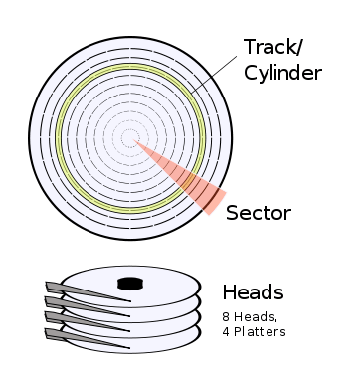
1. CHS Addressing (Cylinder-Head-Sector)
Older addressing method.
Each sector is identified by:
  Cylinder Number
  Head Number
  Sector Number
Example
  Cylinder = 250
  Head = 3
  Sector = 20
The controller moves:
  Head to cylinder 250
  Selects head 3
  Reads sector 20

Slide 41
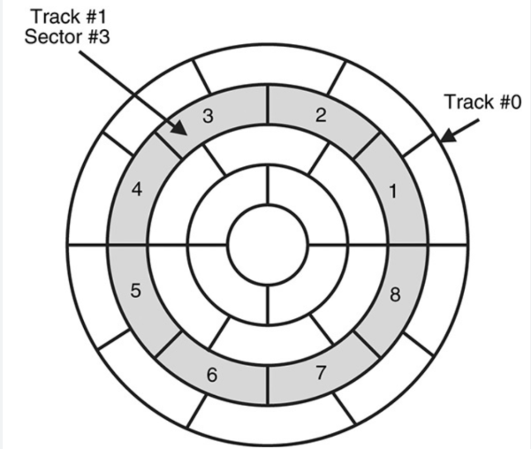
2. LBA (Logical Block Addressing)
Modern HDDs use LBA.
Instead of CHS,
Every sector receives a unique sequential number.
Example
Sector numbers:
0123456...
When OS requests
Block 1,250,000,
The controller automatically converts it into
Cylinder Head Sector
Advantages
Simple, Faster, Supports huge capacities, Used in modern HDDs and SSDs

Slide 42
HDD Performance
Storage performance depends on several timing parameters.
1. Seek Time
  Time required for the head to move to the correct track.
  Average:
  8–12 ms
  Lower seek time is better.

Slide 43
2. Rotational Latency
After reaching the correct track,
The platter must rotate until the desired sector arrives.
Average Latency
Formula:
Average Latency = 60 / (2 × RPM)
Example
  7200 RPM
  Average latency
  ≈ 4.17 ms

Slide 44
3. Transfer Rate
  Speed at which data is transferred.
  Measured in MB/s
  Typical values of HDD is 150–250 MB/s

Slide 45
4. Access Time
Total time needed to access data.
Access Time = Seek Time
  Rotational Latency
  Transfer Time
Example
  Seek Time = 8 ms
  Latency = 4 ms
  Transfer = 1 ms
  Total Access Time = 13 ms

Slide 46
5. IOPS (Input Output Operations Per Second)
  Measures number of read/write operations.
  Typical HDD = 80–200 IOPS
  Enterprise HDD = 250–300 IOPS

Slide 47
Advantages of HDD
  Low cost
  High storage capacity
  Suitable for backups
  Long archival storage
  Widely available
Disadvantages of HDD
  Mechanical parts
  Generates heat
  Noise
  Slow random access
  Sensitive to shock

Slide 48
SOLID STATE DRIVE (SSD)
A Solid State Drive (SSD) is a storage device that stores information using NAND Flash Memory instead of rotating magnetic disks.
Since SSDs contain no moving mechanical parts, they provide significantly higher speed, lower power consumption, and improved reliability.
Modern enterprise storage arrays increasingly use SSDs for applications requiring high performance.
Examples include:
Cloud servers, Banking databases, Artificial Intelligence, Machine Learning
Big Data Analytics, Virtual Machines

Slide 49
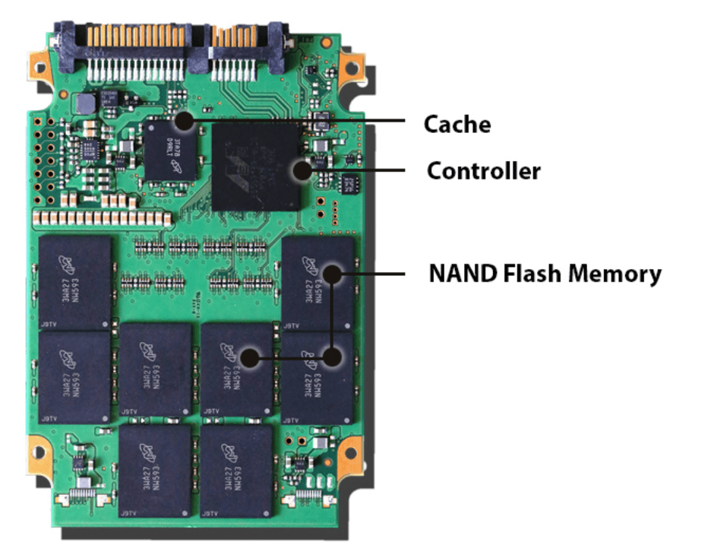
Components of Solid State Disk (SSD)

Slide 50
1. NAND Flash Memory
Stores all user data.
Types include:
  SLC (Single-Level Cell)
  MLC (Multi-Level Cell)
  TLC (Triple-Level Cell)
  QLC (Quad-Level Cell)
  SLC offers the highest speed and reliability but is the most expensive

Slide 51
2. SSD Controller
Acts as the brain of the SSD.
Functions include:
  Wear leveling
  Garbage collection
  Error correction
  Data encryption
  Block management

Slide 52
3. Cache Memory
DRAM Cache
Temporary memory
  Stores
  Mapping tables
  Frequently accessed data
Benefits
  Faster read
  Faster write

Slide 53
4. Flash Translation Layer (FTL)
Acts like a translator.
Converts
Logical Block Address
↓
Physical Flash Memory Address

Slide 54
5. Interface
Common SSD interfaces
SATA SSD
Maximum speed
600 MB/s
NVMe SSD
Uses PCI(Peripheral Component Interconnect) Express
Speed
3000 MB/s
5000 MB/s
7000 MB/s
or higher

Slide 55
Working Principle of SSD
Host sends request.
SSD controller identifies flash block.
Data is read electronically.
Controller performs error correction.
Data is delivered to host.
Since there are no moving parts, access time is extremely low

Slide 56
Addressing in SSD
SSD does not use
Tracks, Cylinders, Heads
Instead,
Operating System sends
Logical Block Address
↓
Flash Translation Layer
↓
Physical Flash Memory
↓
Controller accesses NAND Cells
This process is transparent to the operating system.

Slide 57
SSD Performance
1. Read Speed
SATA SSD
500 MB/s
NVMe SSD
3000–7000 MB/s
2. Write Speed
Usually slightly lower than read speed.
Depends on
Controller
NAND type
Cache

Slide 58
SSD Performance
3. Access Time
Very small.
Approximately
0.05–0.1 ms
Compared to HDD
10–15 ms
4. IOPS
Consumer SSD
50,000–100,000 IOPS
Enterprise SSD
500,000+ IOPS
Much higher than HDD.

Slide 59
SSD Performance
5. Endurance
Measured using
TBW (Terabytes Written)
DWPD (Drive Writes Per Day)
Wear leveling increases lifespan.

Slide 60
Real-World Applications
Hard Disk Drives (HDDs)
Backup servers
Surveillance video storage
Media libraries
Large-capacity archival systems
Cost-sensitive storage solutions

Slide 61
Real-World Applications
Solid-State Drives (SSDs)
Laptops and desktops
Cloud servers
Database servers
Virtual machines
AI and machine learning workloads
High-performance gaming systems

Slide 62
RAID – REDUNDANT ARRAY OF INDEPENDENT DISKS

Slide 63
Introduction to RAID
RAID (Redundant Array of Independent Disks) is a storage technology that combines multiple physical hard disk drives (HDDs) or solid-state drives (SSDs) into a single logical storage unit to improve one or more of the following:
  Performance
  Reliability
  Availability
  Storage Capacity

Slide 64
Why RAID is Needed?
A single disk has several limitations:
  Limited storage capacity
  Single point of failure
  Lower read/write performance
  Difficult recovery after failure
  RAID solves these problems by distributing data across multiple disks.

Slide 65
Example
Suppose a company stores customer banking records on a single hard disk.
If that disk fails:
  Entire database becomes unavailable
  Business operations stop
  Data recovery is difficult
Using RAID:
  Data is copied or distributed across multiple disks.
  If one disk fails, data can still be recovered.

Slide 66
Objectives of RAID
RAID aims to achieve:
Increased Performance
Fault Tolerance
High Availability
Increased Storage Capacity
Data Protection

Slide 67
2. Basic RAID Terminology
Disk Striping
Striping means dividing data into small blocks and distributing them across multiple disks.
Example
Suppose a file contains:
A B C D E F G H
Stored across four disks:
Disk1 A E
Disk2 B F
Disk3 C G
Disk4 D H

Slide 68
Data Mirroring
Mirroring stores an exact copy of data on another disk.
Disk1
File A
File B
File C
Disk2
File A
File B
File C
If Disk1 fails,
Disk2 contains identical information.

Slide 69
Parity
Parity is extra information used to reconstruct lost data.
Instead of copying complete data (mirroring), RAID stores parity bits.
Example
Data Blocks
A
B
C
Parity
P = A XOR B XOR C
If one block is lost,
It can be recreated using XOR operations.
Parity provides:
Fault tolerance
Less storage overhead than mirroring

Slide 70
RAID Controller
A RAID controller manages the RAID array.
Functions include:
  Data distribution
  Parity calculation
  Disk monitoring
  Error detection
  Recovery
Types:
  Hardware RAID Controller
  Software RAID Controller

Slide 71
3. RAID Concepts
RAID uses three main techniques:
Striping
Improves speed.
Mirroring
Improves reliability.
Parity
Provides fault tolerance with less storage overhead.

Slide 72
4. RAID Levels
There are several RAID levels.
The most common are:
  RAID 0
  RAID 1
  RAID 2
  RAID 3
  RAID 4
  RAID 5
  RAID 6
  RAID 10

Slide 73
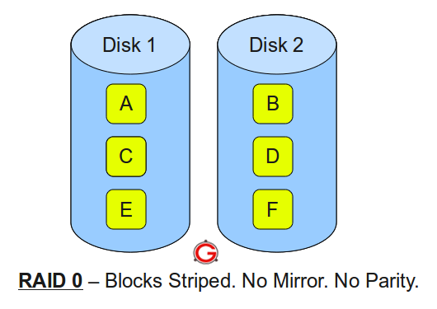
RAID 0 (Striping)
Working Principle
Data is divided into blocks and distributed across disks.
Characteristics
  Minimum disks: 2
  Fault tolerance: No
  Performance: Very High
  Storage efficiency: 100%
Advantages
  Fastest RAID
  Excellent read and write speed
  Full storage utilization
Disadvantages
  No redundancy
  One disk failure destroys entire array

Slide 74
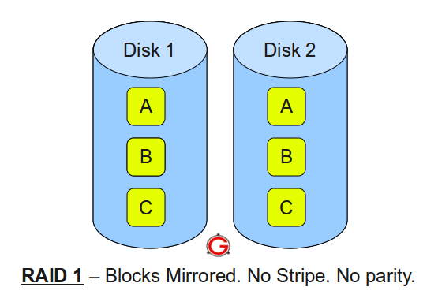
RAID 1 (Mirroring)
Working Principle
Every disk has an identical copy.
Characteristics
Minimum disks: 2
Fault tolerance: Excellent
Performance: Read – High, Write - Moderate
Storage efficiency - 50%
Advantages
High reliability, Easy recovery, Excellent read performance
Disadvantages
Expensive and Half the storage is usable

Slide 75
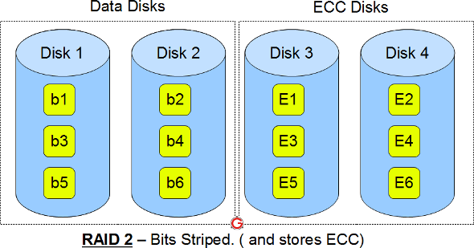
RAID 2
Bit-Level Striping: Data is split up and spread across multiple data disks one individual bit at a time.
Hamming Code Parity: Dedicated extra drives store linear error-correction bits.
Fault Tolerance: Can detect and correct single-bit errors and identify multi-bit failures

Slide 76
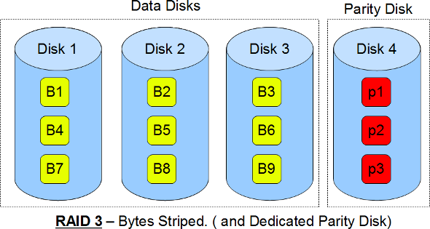
RAID 3
Uses:
Data is split into tiny pieces (bytes) and written evenly across all data drives at the same time.
A special mathematical calculation called parity is run on those bytes.
This parity code is saved onto the one dedicated parity drive.
If one data or parity drive breaks, the system uses the remaining bytes and parity math to rebuild the lost information on the fly.
Advantages
High sequential read
Disadvantages
Parity disk bottleneck
Applications
Large multimedia files

Slide 77
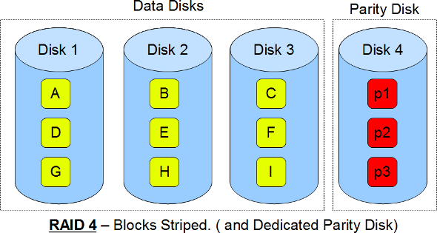
RAID 4
Uses
Block-level striping
Dedicated parity disk
Better random reads than RAID 3.
Still suffers parity bottleneck.

Slide 78
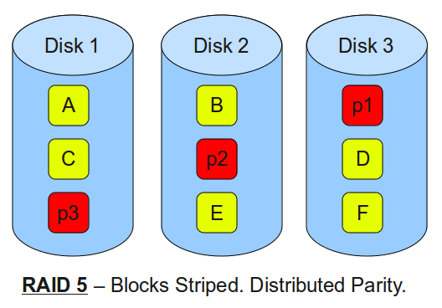
RAID 5 (Most Popular)
Uses:
Block striping
Distributed parity
Parity rotates across disks.
Characteristics
Minimum disks:3
Fault tolerance: One disk failure
Performance - Read: High, Write: Moderate
Storage efficiency: (N-1)/N

Slide 79
RAID 5 (Most Popular)
Example
4 disks
Storage: 4 × 1 TB = 4 TB
Usable: 3 TB
Advantages
Excellent balance
High capacity
Good fault tolerance
Disadvantages
Slow rebuild
Write penalty
Cannot survive two failures

Slide 80
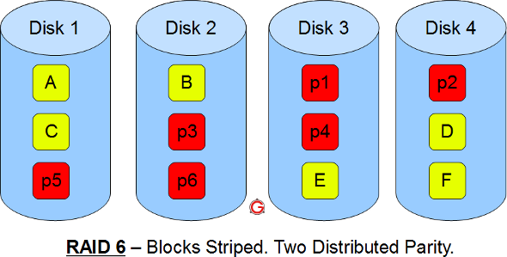
RAID 6
Uses:
Block striping
Dual distributed parity
Characteristics
Minimum disks: 4 Can survive
Two disk failures
Storage: N-2
Advantages
Very high reliability
Better protection than RAID 5
Disadvantages
Higher write overhead
Longer rebuild

Slide 81
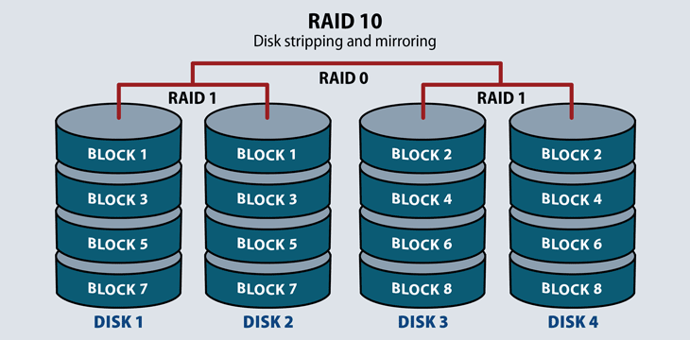
RAID 10 (RAID 1 + RAID 0)
Combination of Mirroring and Striping
Characteristics
Minimum disks: 4
Performance: Very High
Fault tolerance: Excellent
Storage efficiency: 50%
Advantages
High speed & availability
Quick recovery
Disadvantages
Costly & Requires many disks

